Slide 1
Big Mountain Resort: Pricing and Strategy Overview
Rasheed Mehrinfar

Slide 2
Problem Identification
Big Mountain Resort is seeking to optimize its ticket pricing and operational investments to maximize revenue and enhance the guest experience. The resort leadership aims to better understand which factors drive premium pricing and how operational changes could improve competitive positioning.

Slide 3
Project Objectives
Understand key drivers of ski resort pricing using data from 330+ North American resorts
Model how operational investments (lifts, terrain expansion, differentiated offerings) impact pricing potential
Provide actionable recommendations to inform strategic decisions
Support data-driven revenue management and long-term market positioning

Slide 4
Recommendations and Key Findings
Recommendations:
Prioritize investment in high-speed quad lifts to elevate market positioning
Expand skiable terrain and promote vertical drop features
Differentiate through terrain parks and night skiing to attract new market segments
Adopt a dual strategy of infrastructure improvement and targeted marketing
Key Findings:
Vertical drop, summit elevation, skiable area, and fast quad lifts are primary pricing drivers
Scenario modeling highlights revenue sensitivity to terrain availability and lift investments

Slide 5
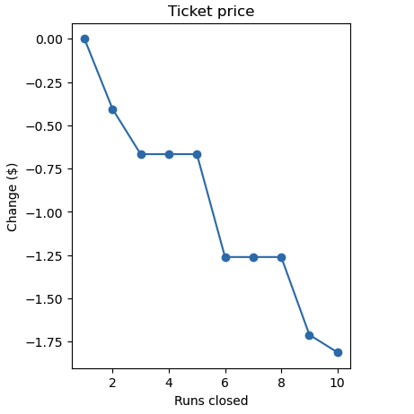
Modeling Results and Analysis (1/3)
Key Pricing Drivers
Insights:
Reducing available runs significantly impacts pricing
Terrain availability and operational capacity must be actively managed and communicated to preserve price integrity

Slide 6
Modeling Results and Analysis (2/3)
Scenario: Vertical Drop Increase
Based on scenario modeling outputs:
A 10% increase in vertical drop is projected to increase predicted ticket prices
Enhancing perceived or actual vertical drop through marketing or terrain optimization can drive additional revenue

Slide 7
Modeling Results and Analysis (3/3)
Scenario: Fast Quad Lift Expansion
Based on scenario modeling outputs:
Adding 2 fast quad lifts yields measurable gains in predicted ticket prices
Lift infrastructure is a high-impact lever — investing in fast quads is a strategic priority

Slide 8
Summary and Conclusion
Infrastructure improvements (lifts, terrain) drive measurable pricing gains
Differentiated offerings broaden market appeal
Immediate next steps:
Conduct A/B testing on pricing strategies
Integrate seasonal trends and visitor demographics into future models
Explore dynamic pricing using weather, holiday, and competitor data
Conclusion: Big Mountain Resort should pursue a dual strategy of operational enhancements and strategic market repositioning to maximize long-term revenue growth

